Slide 1
Interactive Web Development Experience
- Introduction to HTML and CSS;
- Writing Tags; - How The Web Works; - Welcome to HTML- Practical application
By:
Akhil R Pillai Roshni Kashyap

Slide 2

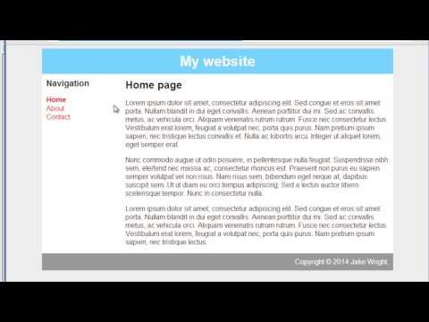
Introduction to HTML and CSS

Slide 3
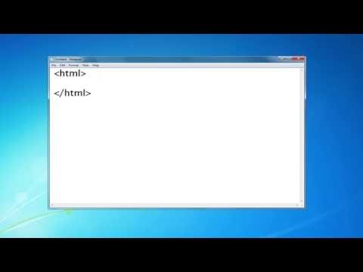
Writing tags

Slide 4
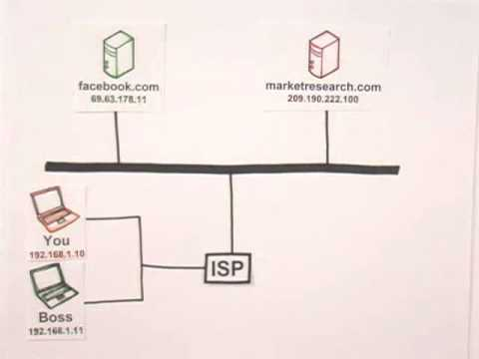
How the web works

Slide 5
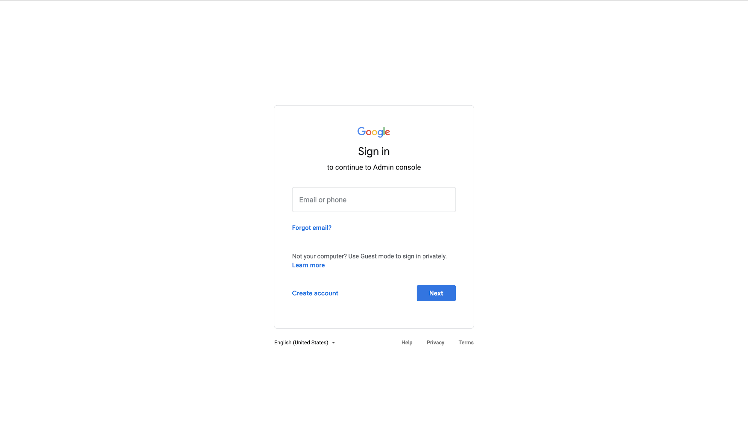
Welcome to HTML -Exercise 1

Slide 6
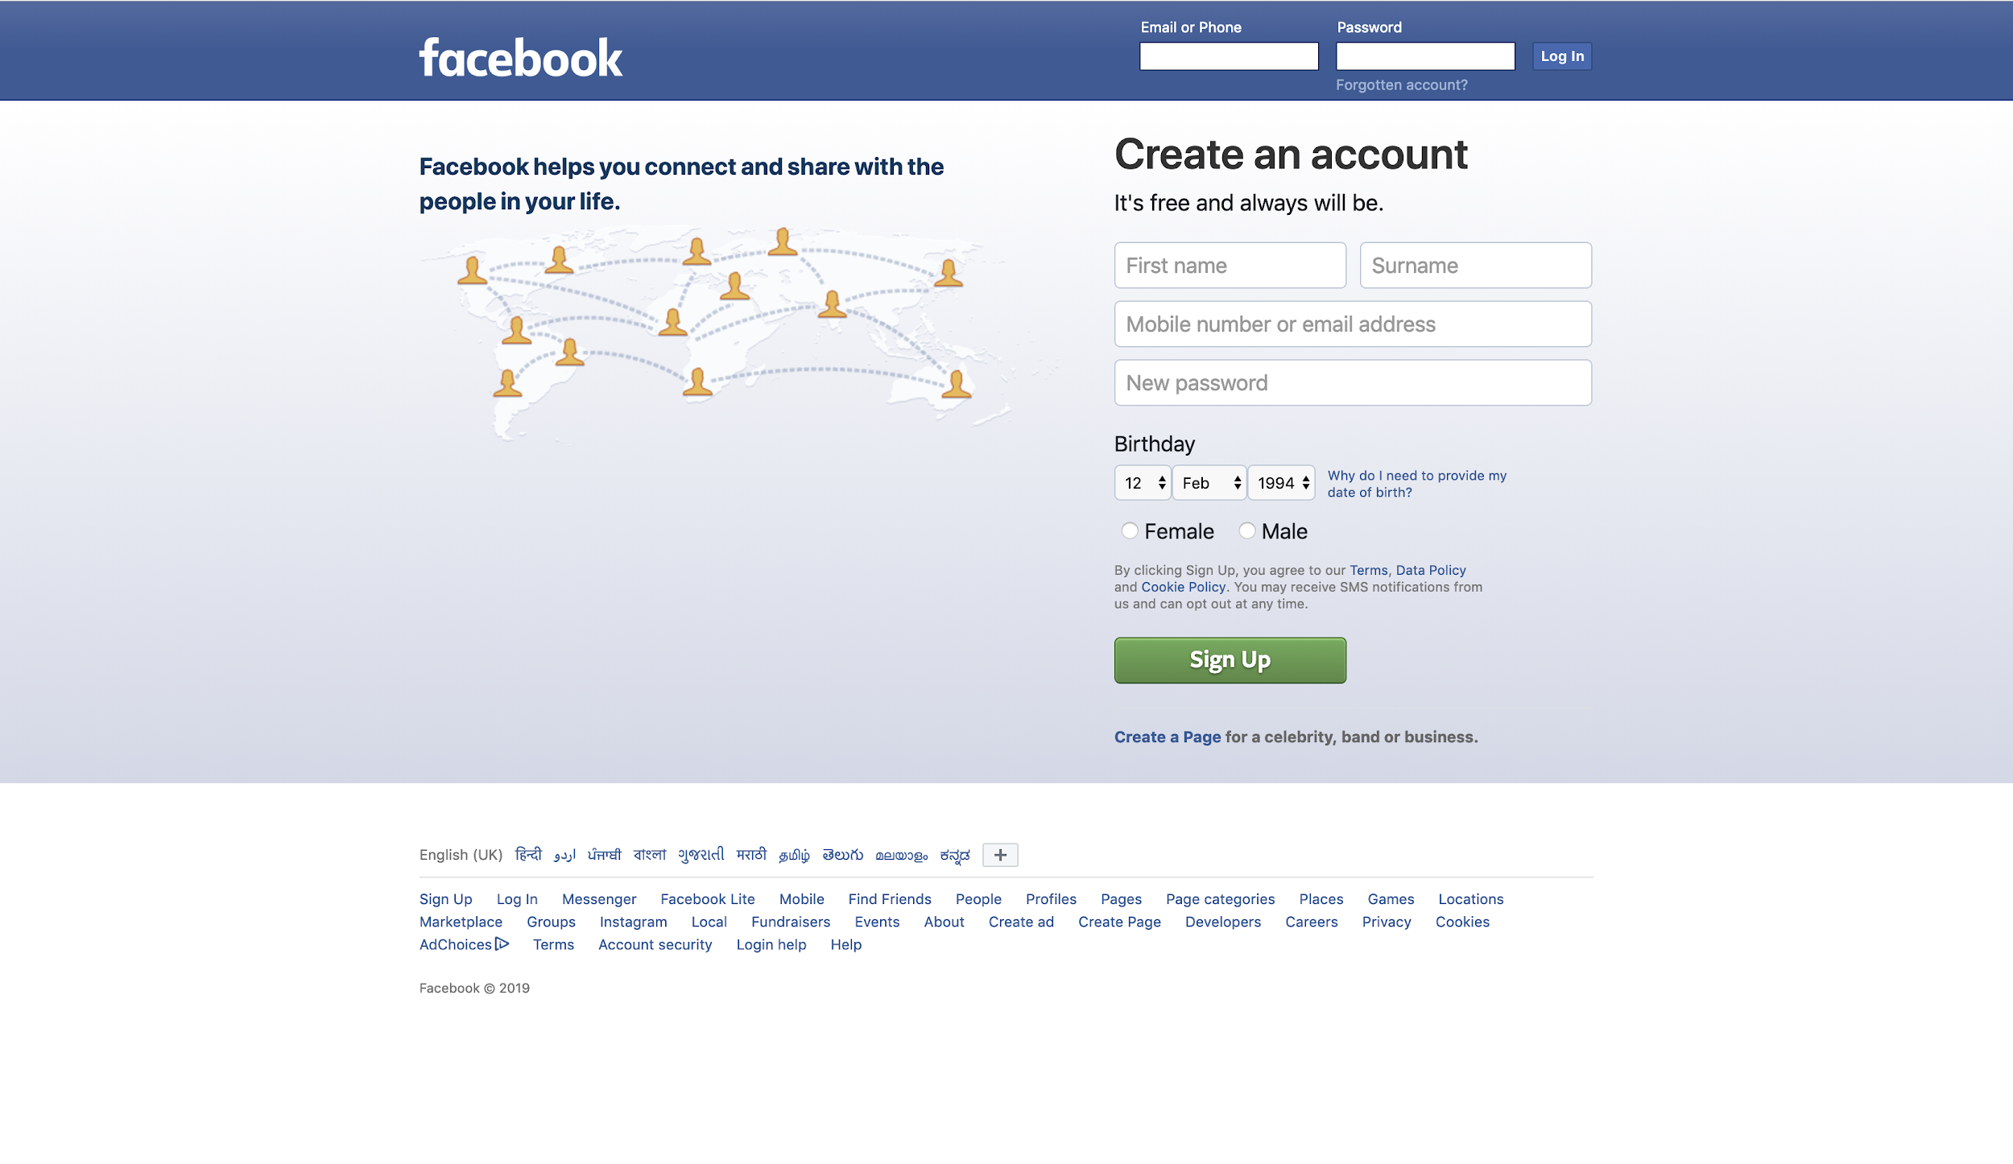
Welcome to HTML- Exercise 2

Slide 7
You can use
HTML
CSS
JS
-Page should be Responsive. Include media queries
-Open book practical exam.
-Collect source images and fonts from google home page.
-Try to make the page interactive and include animations, if possible.

Slide 8
Thank you

